Slide 1

Dayananda Sagar College of Engineering
Department of Computer Science & Engineering
INTERNSHIP 2023-2024
Name: Pilla Shanmukha Dhanush
USN: 1DS21CS138
Name of the company: Win Research Center
DAYANANDA SAGAR COLLEGE OF ENGINEERING

Slide 2
CONTENTS 1. INTRODUCTION 2. OVERVIEW OF THE COMPANY 3. LITERATURE REVIEW 4. OBJECTIVE 5. METHODOLOGY 6. RESULT ANALYSIS 7. SNAPSHOTS 8. APPLICATIONS AND LIMITATIONS
DAYANANDA SAGAR COLLEGE OF ENGINEERING

Slide 3
INTRODUCTION
Developed a comprehensive fitness management system that integrates a user-friendly interface for gym booking and scheduling sessions with nutritionists and trainers. The system should also include a social platform enabling users to share their fitness journey, health tips, and connect with a like-minded community. Leveraging Django for backend functionalities and HTML/CSS/JavaScript for frontend, the solution should incorporate machine learning and artificial intelligence to personalize recommendations, analyze user data for tailored fitness plans, and optimize user experience. The project aims to streamline fitness routines, enhance user engagement, and foster a supportive environment for holistic wellness.
DAYANANDA SAGAR COLLEGE OF ENGINEERING

Slide 4
OVERVIEW OF THE COMPANY
About The Win Research Institute
Location: South India, tech hub
Renowned for: Pioneering work in Technology, Healthcare, Engineering, and Social Sciences
Interdisciplinary Approach:
Collaborations among diverse experts
Sparks creativity and innovation
Addresses real-world challenges
State-of-the-Art Facilities:
Cutting-edge technologies
Attracts top-tier global researchers and scholars
DAYANANDA SAGAR COLLEGE OF ENGINEERING

Slide 5
Achievements & Mission
Educational Commitment:
Nurtures young talent
Offers educational programs, internships, and hands-on learning opportunities
Achievements:
100% success rate in Market Research, Problem Identification, and Business Intelligence
Mission:
Push boundaries of knowledge and innovation
Drive innovation and efficiency with cutting-edge software solutions
Create technology that empowers, streamlines, and enriches human experience
Global Impact: Shaping the future landscape of research and development
DAYANANDA SAGAR COLLEGE OF ENGINEERING

Slide 6
LITERATURE REVIEW
Existing Fitness Management Systems:
Overview of current fitness management platforms
Common features: booking systems, training sessions, social interaction
Technological Integration:
Use of AI and ML in personalized fitness recommendations
Importance of user-friendly interfaces (HTML/CSS/JavaScript)
Industry Trends:
Increasing demand for holistic wellness platforms
Growth of digital fitness communities
DAYANANDA SAGAR COLLEGE OF ENGINEERING

Slide 7
OBJECTIVE
Primary Goal:
Develop a comprehensive fitness management system.
Specific Objectives:
Integrate user-friendly interface for gym booking and scheduling
Include a social platform for sharing fitness journeys and health tips
Leverage AI/ML for personalized recommendations and data analysis
Enhance user engagement and foster a supportive wellness community
DAYANANDA SAGAR COLLEGE OF ENGINEERING

Slide 8
METHODOLOGY
Development Approach:
Backend: Django framework for server management and data handling
Frontend: HTML/CSS/JavaScript for user interface
Optional: Frontend frameworks like React, Angular, or Vue.js
Data Management:
Database integration (PostgreSQL or MySQL)
AI/ML Integration:
Utilization of libraries like scikit-learn, TensorFlow, or PyTorch
Version Control:
Git for version control and collaboration
DAYANANDA SAGAR COLLEGE OF ENGINEERING

Slide 9
RESULT ANALYSIS
The results of the Fitness Management System project have been transformative, redefining how individuals engage with their wellness journeys. Through seamless integration of technology and fitness, the system has provided users with unparalleled convenience in managing their fitness routines. Streamlining gym bookings, enabling consultations with experts, and harnessing AI for personalized fitness plans have not only simplified the process but also enhanced the effectiveness of each user's fitness journey. Moreover, the creation of a vibrant community space within the platform has fostered an environment of support, encouragement, and knowledge sharing among users. This culmination of technological innovation and community-driven interaction has yielded a paradigm shift in fitness engagement, empowering users to pursue their health goals with greater enthusiasm and efficiency.
DAYANANDA SAGAR COLLEGE OF ENGINEERING

Slide 10
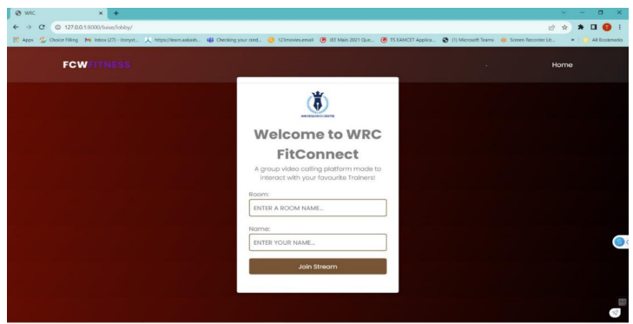
SNAPSHOTS
DAYANANDA SAGAR COLLEGE OF ENGINEERING

Slide 11
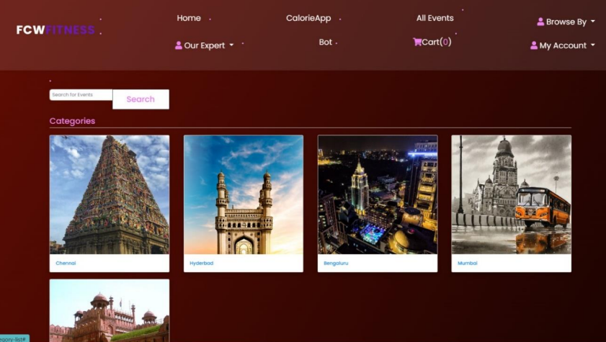
DAYANANDA SAGAR COLLEGE OF ENGINEERING

Slide 12
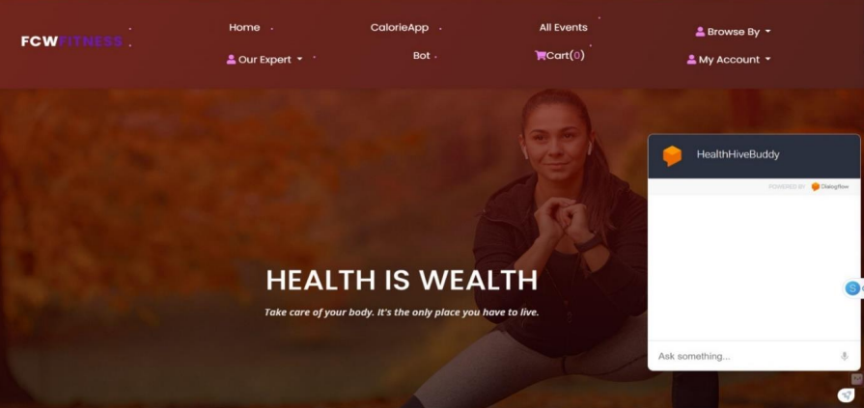
DAYANANDA SAGAR COLLEGE OF ENGINEERING

Slide 13
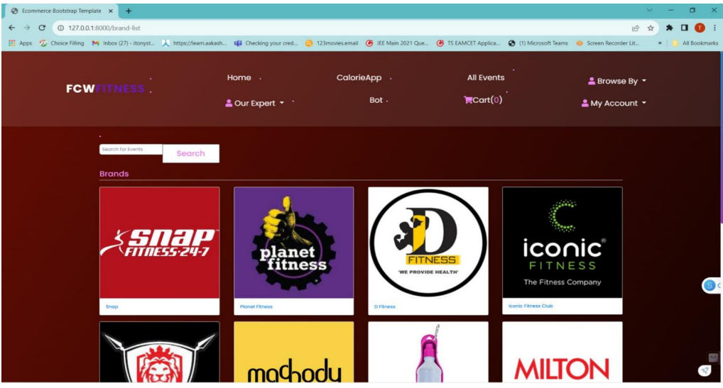
DAYANANDA SAGAR COLLEGE OF ENGINEERING

Slide 14
APPLICATIONS AND LIMITATIONS
APPLICATIONS
User Engagement:
Seamless gym booking and session scheduling
Social platform for sharing journeys and health tips
Personalization:
AI-driven personalized fitness plans and recommendations
Community Building:
Interactive space for users to connect and support each other
Efficiency:
Streamlined fitness routines and enhanced user experience
DAYANANDA SAGAR COLLEGE OF ENGINEERING

Slide 15
LIMITATIONS
Technical Challenges:
Complexity of integrating AI/ML algorithms
Ensuring seamless interaction between backend and frontend
User Data Privacy:
Ensuring robust data security and privacy measures
Scalability:
Handling increased user load and maintaining performance
Resource Intensity:
High resource requirement for machine learning computations
Adoption:
User adaptation to new technology and platform features
DAYANANDA SAGAR COLLEGE OF ENGINEERING

